Slide 1


TACTICAL COMBAT CASUALTY CARE COURSE
Module 24: Prepare For Evacuation
MODULE 24: PREPARE FOR EVACUATION
TCCC TIER 1
All Service Members
TCCC TIER 2
Combat Lifesaver
TCCC TIER 3
Combat Medic/Corpsman
TCCC TIER 4
Combat Paramedic/Provider

Slide 2




Module 24: Prepare For Evacuation
TACTICAL COMBAT CASUALTY CARE (TCCC) ROLE-BASED TRAINING SPECTRUM
ROLE 1 CARE
NONMEDICAL PERSONNEL
MEDICAL PERSONNEL
YOU ARE HERE
STANDARDIZED JOINT CURRICULUM
2

Slide 3







Module 24: Prepare For Evacuation
1 x TERMINAL LEARNING OBJECTIVES
Given a combat or noncombat scenario, prepare casualties for evacuation during Tactical Field Care in accordance with CoTCCC Guidelines.
27
  Identify considerations and fundamental procedures for staging casualties for evacuation.
  Identify the importance of pre-mission evacuation equipment preparation and rehearsals.
  Identify considerations and precautions required for evacuating casualties with suspected spinal injuries.
  Identify critical actions and checks to prepare casualties for evacuation.
  Identify methods of litter selection and evacuation equipment in Tactical Field Care.
  Identify considerations for evacuating ambulatory/walking wounded casualties in Tactical Field Care.
  Demonstrate the preparation of a casualty for evacuating in Tactical Field Care.
  Identify considerations in the transition of care during Tactical Evacuation Care.
  Identify the responsibilities of tactical force personnel in Tactical Evacuation Care
09 x ENABLING LEARNING OBJECTIVES
= Terminal Learning Objectives = Cognitive ELOs = Performance ELOs
#
3

Slide 4

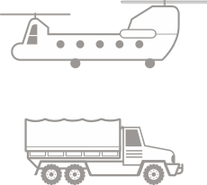
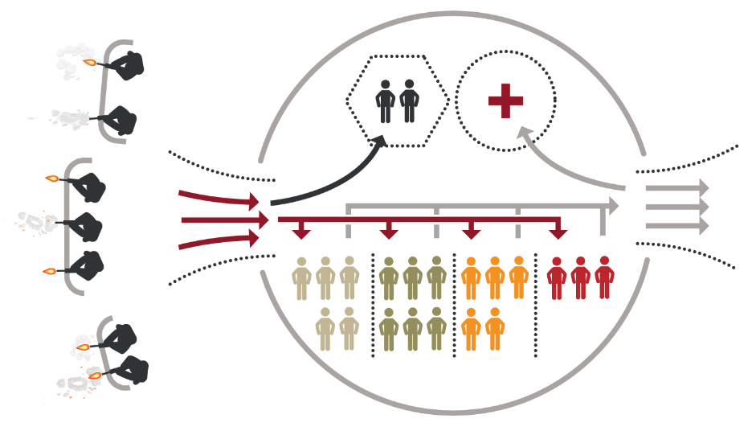

Module 24: Prepare For Evacuation
PREPARE FOR EVACUATION OVERVIEW
Package Casualties:
Secure loose bandages and ties
Secure hypothermia prevention materials
Consider padding
Secure litter straps
Load casualties and transition care to receiving evacuation team
Complete DD Forms 1380
C&oamttpalcehtetoDD
Stage Casualties:
Move casualties to evacuation site
Provide ambulatory casualty guidance
Forms 1380
casualties and attach to casualties
CHALLENGES TO EVACUATIONS
Unsecure tactical environment Loud noise conditions
Physically difficult casualty transfers
ESTABLISH & MAINTAIN
security at evacuation point
4

Slide 5


CASUALTY COLLECTION POINT

Slide 6



Module 24: Prepare For Evacuation
CASUALTY EVACUATION STAGING
STAGE in close proximity to the evacuation site
If not at treatment site, MOVE TO STAGING AREA when evac assets are in route
PROTECT CASUALTIES from
environmental elements
MONITOR for hypothermia and dehydration
ARRANGE CASUALTIES IN ORDER
of loading precedence (usually routine first and urgent last)
1
Ambulatory and routine casualties
ROUTINE
2
Priority casualties
PRIORITY
3
Urgent casualties
Evacuation personnel dictate the exact order of casualty movement
Periodically reassess MARCH-PAWS interventions
URGENT
6

Slide 7
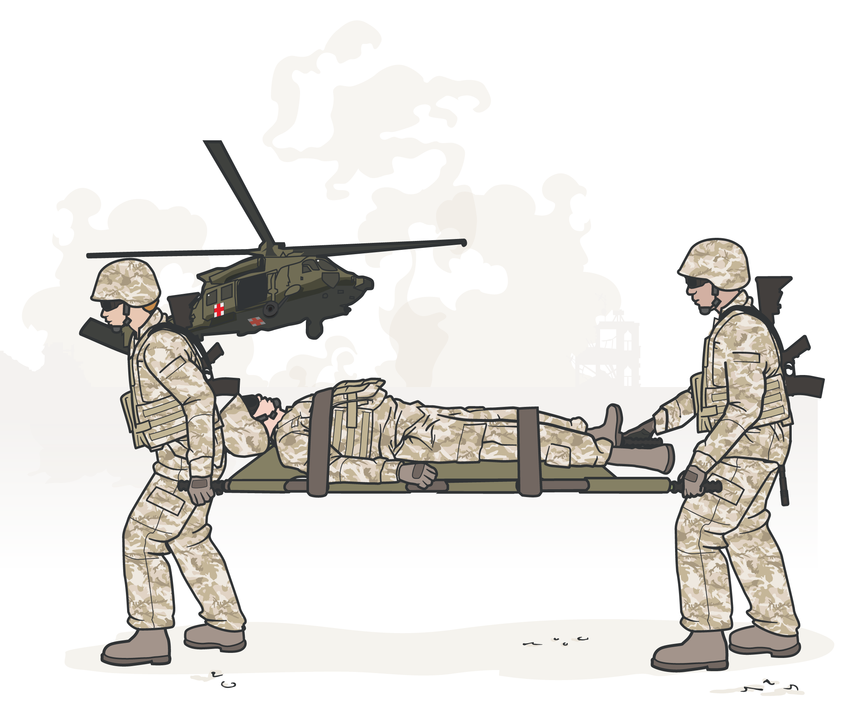
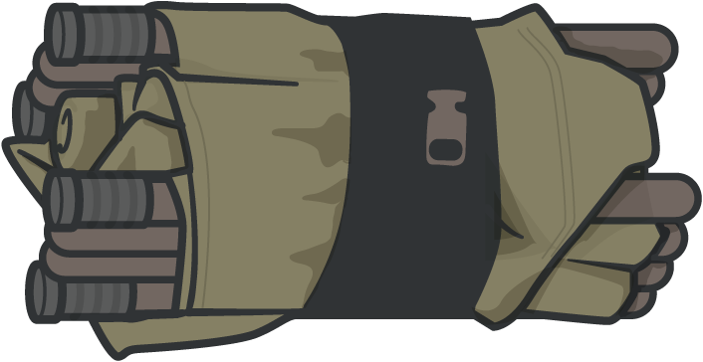

Module 24: Prepare For Evacuation
PRE-MISSION EQUIPMENT PREP AND REHEARSALS
PREPARE EVACUATION EQUIPMENT
Unit members should all know:
How to use evac equipment (set-up and actual use)
Where to find equipment during a mission (storage location)
PRE-MISSION REHEARSALS
Primary roles for each member Cross-training in other roles
Comprehensive dress rehearsals with simulated field conditions
Establish leadership / Uncover weaknesses / Build confidence
CMC must inspect & inventory evacuation equipment prior to deployment and every mission
7

Slide 8




Module 24: Prepare For Evacuation
CRITICAL ACTIONS TO PREPARE CASUALTIES
Complete and secure
DD Form 1380 to the casualty
Secure all loose ends of bandages and wraps, and equipment
Secure hypothermia prevention wraps & blankets
Secure litter straps, consider additional padding
Attach DD Form 1380 to the casualty in a prominent location (wrist, belt loop of pants, etc.)
Ensure casualty’s weapons and equipment have been secured, as appropriate
8

Slide 9
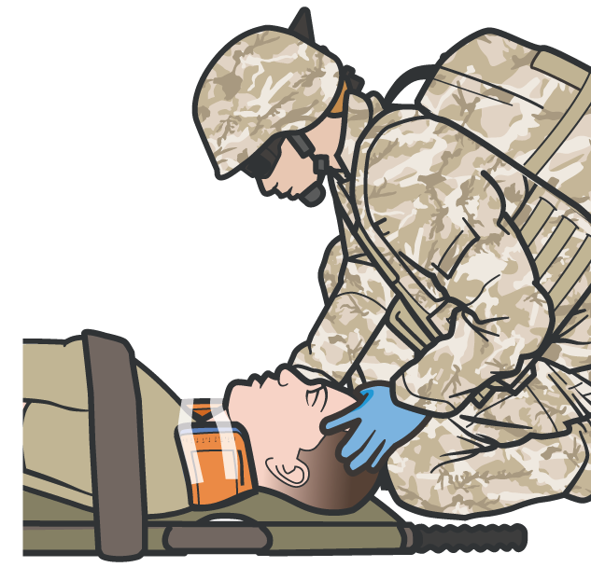
Module 24: Prepare For Evacuation
SUSPECTED SPINAL INJURY CONSIDERATIONS
C-spine stabilization is not necessary for casualties who have sustained only penetrating trauma
CONSIDER SPINAL INJURY in casualty with:
Blunt trauma with spinal pain
Visible hematoma/swelling along spine Radiating pain, unexplained sensory loss
Spinal immobilization is not a primary objective of Care Under Fire or Tactical Field Care
USE RIGID LITTER with adequate support to protect the spinal cord from sustaining secondary injury
If the tactical situation allows, consider addressing in preparation for Tactical Evacuation Care
CONSIDER USING MALLEABLE SPLINT
to form C-collar if cervical injury is suspected
Long spine boards and immobilization materials usually not available – consider requesting special equipment from MEDEVAC
9

Slide 10
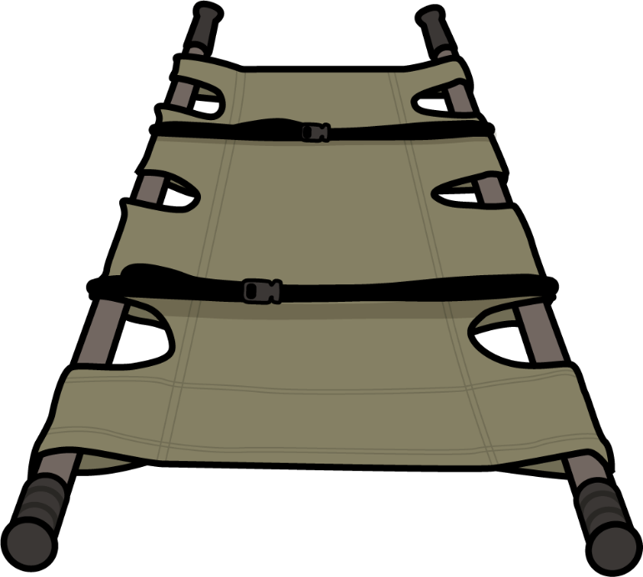
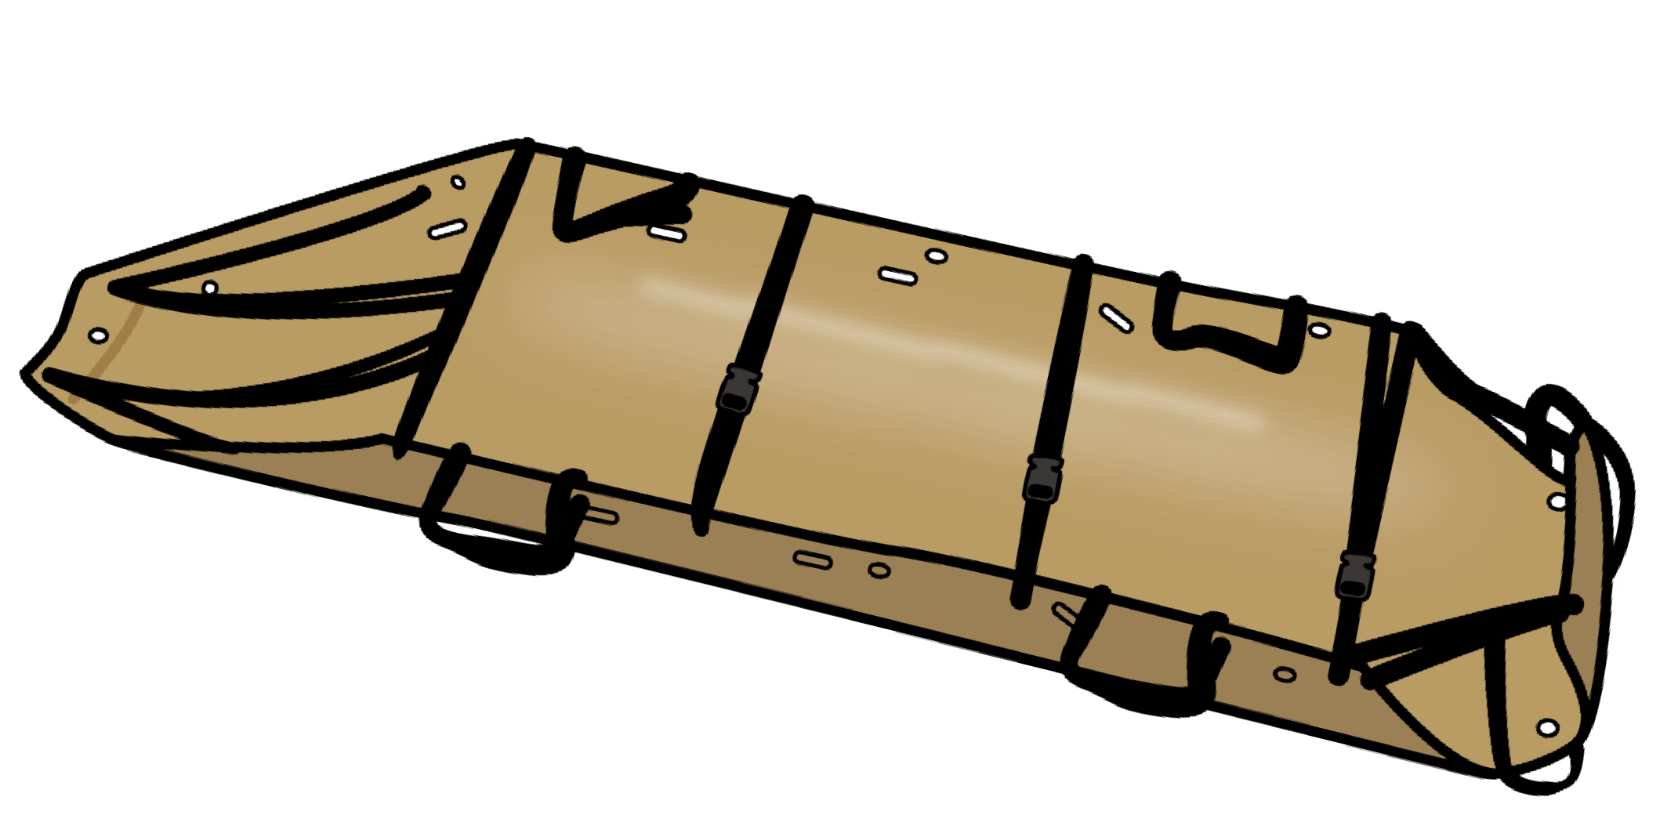
Module 24: Prepare For Evacuation
LITTER SELECTION
AND EVACUATION EQUIPMENT
Evacuation equipment considerations: Unit standard operating procedures
Deployed mission environment (tactical situation, terrain, weather, and evacuation assets)
DO NOT DELAY getting casualties onto litters
Hypothermia is easier to prevent
off the ground
Easier to move casualty on litter
Collapsible litter pros/ cons:
Most common litters
Rigid poles/grips aid in transport/rough terrain
Integrated litter straps
Collapsible handles support H-60 MEDEVACs
Sled type litters pros/cons:
No rigid poles – difficult grip over long distances
Integrated straps Some hoist-certified
Plastic – supports sliding on smooth surfaces
Needs good padding
Train on unit equipment, but familiarize yourself with as many different types as feasible
10

Slide 11
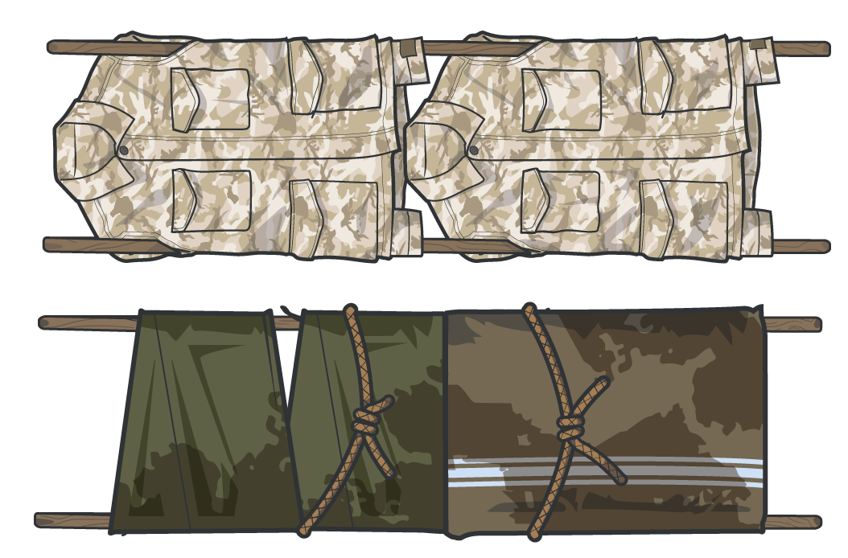
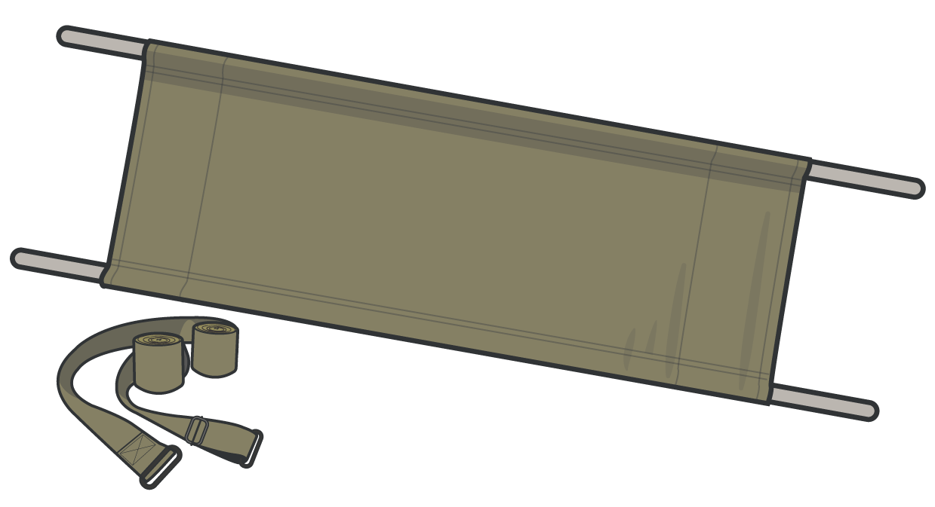
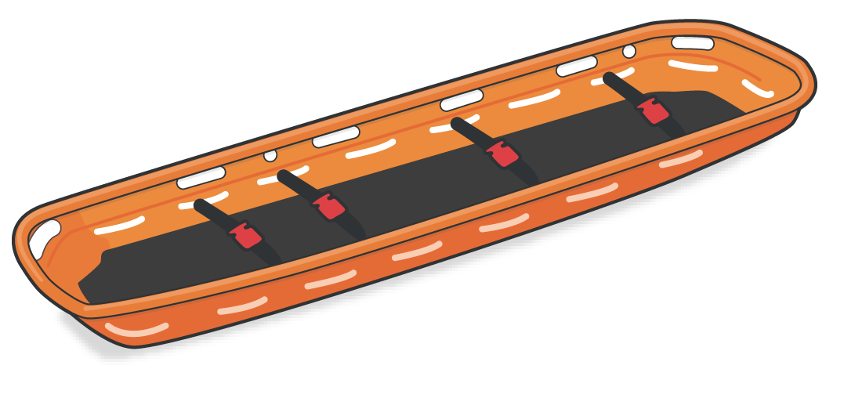
Module 24: Prepare For Evacuation
LITTER SELECTION
AND EVACUATION EQUIPMENT (cont.)
“Army standard litter” pros/cons:
Basket type litter pros/cons:
Improvised litter pros/cons:
Poles don’t collapse Requires external litter straps
Commonly seen in multinational operations
Usually found in rescue units
Some (not all) litters fit inside basket
Can be dragged
Generally, preferred litter for hoisting
Rigid pole materials often difficult to locate
Can be made with rope, blankets or jackets
If not properly constructed, potential for harm to casualty
Significant variation exists within NATO litter standards

Slide 12
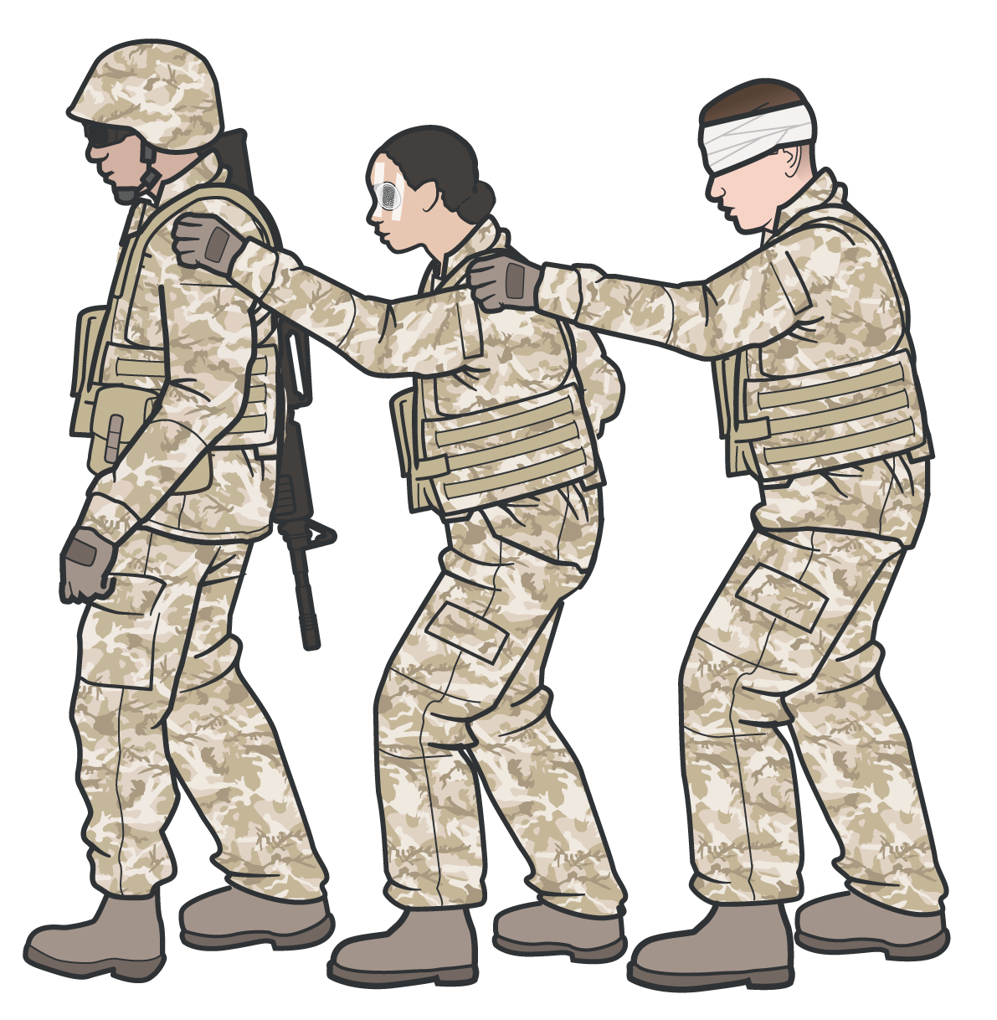
Module 24: Prepare For Evacuation
AMBULATORY CASUALTY CONSIDERATIONS
Can the ambulatory casualty help?
Are they capable of providing security? Could they help lift a litter patient?
Can they help other ambulatory casualties?
Disoriented or visually impaired casualties require supervision to be evacuated
When moving, line up casualties and have each place their hand on the shoulder of the casualty in front
of them
Assign uninjured unit member as POC
Answer questions for ambulatory casualties Periodically reassess ambulatory casualties
Instruct casualties to repeatedly check their wounds and dressings & ensure that bleeding remains controlled

Slide 13
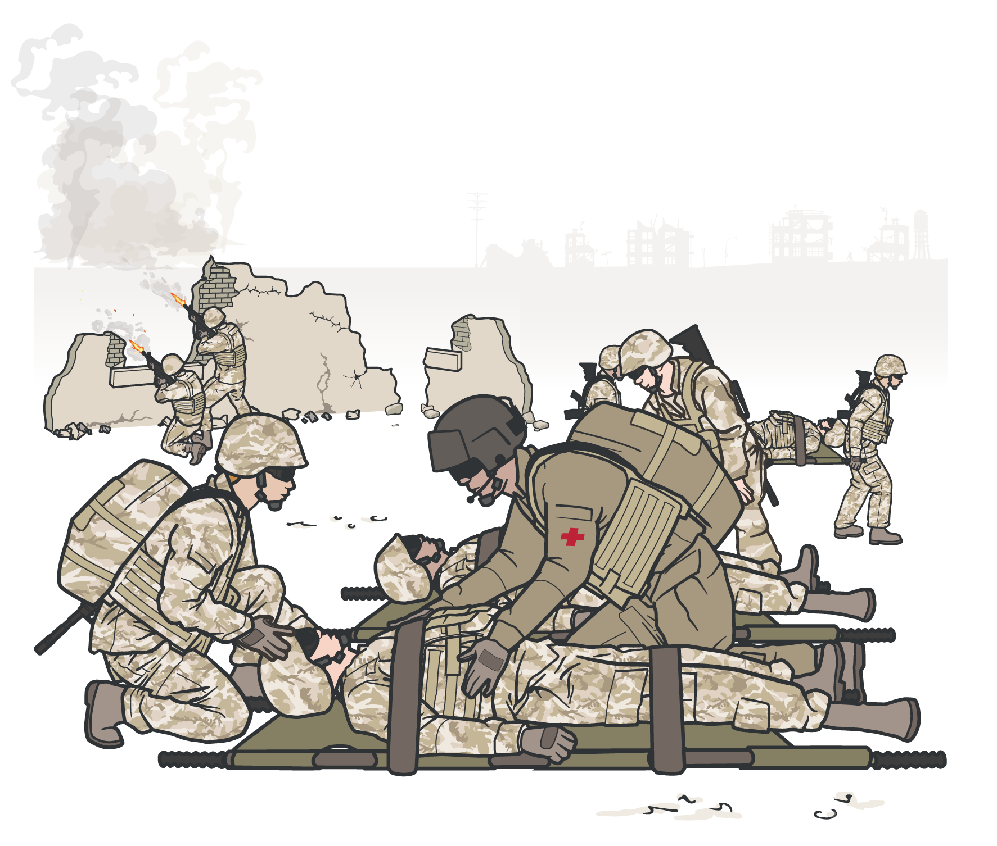
Module 24: Prepare For Evacuation
TACTICAL FORCE PERSONNEL RESPONSIBILITIES
Tactical force personnel are responsible for: Identifying an evacuation site
Marking and preparing the evacuation site Securing the evacuation site
Leadership is tasked with Ensuring the safety of casualties
Ensuring the safety of tactical personnel
Maintaining awareness of potential hostile threats that could impact the success of the evacuation
The entire unit, including medical personnel, should be prepared to support security requirements

Slide 14
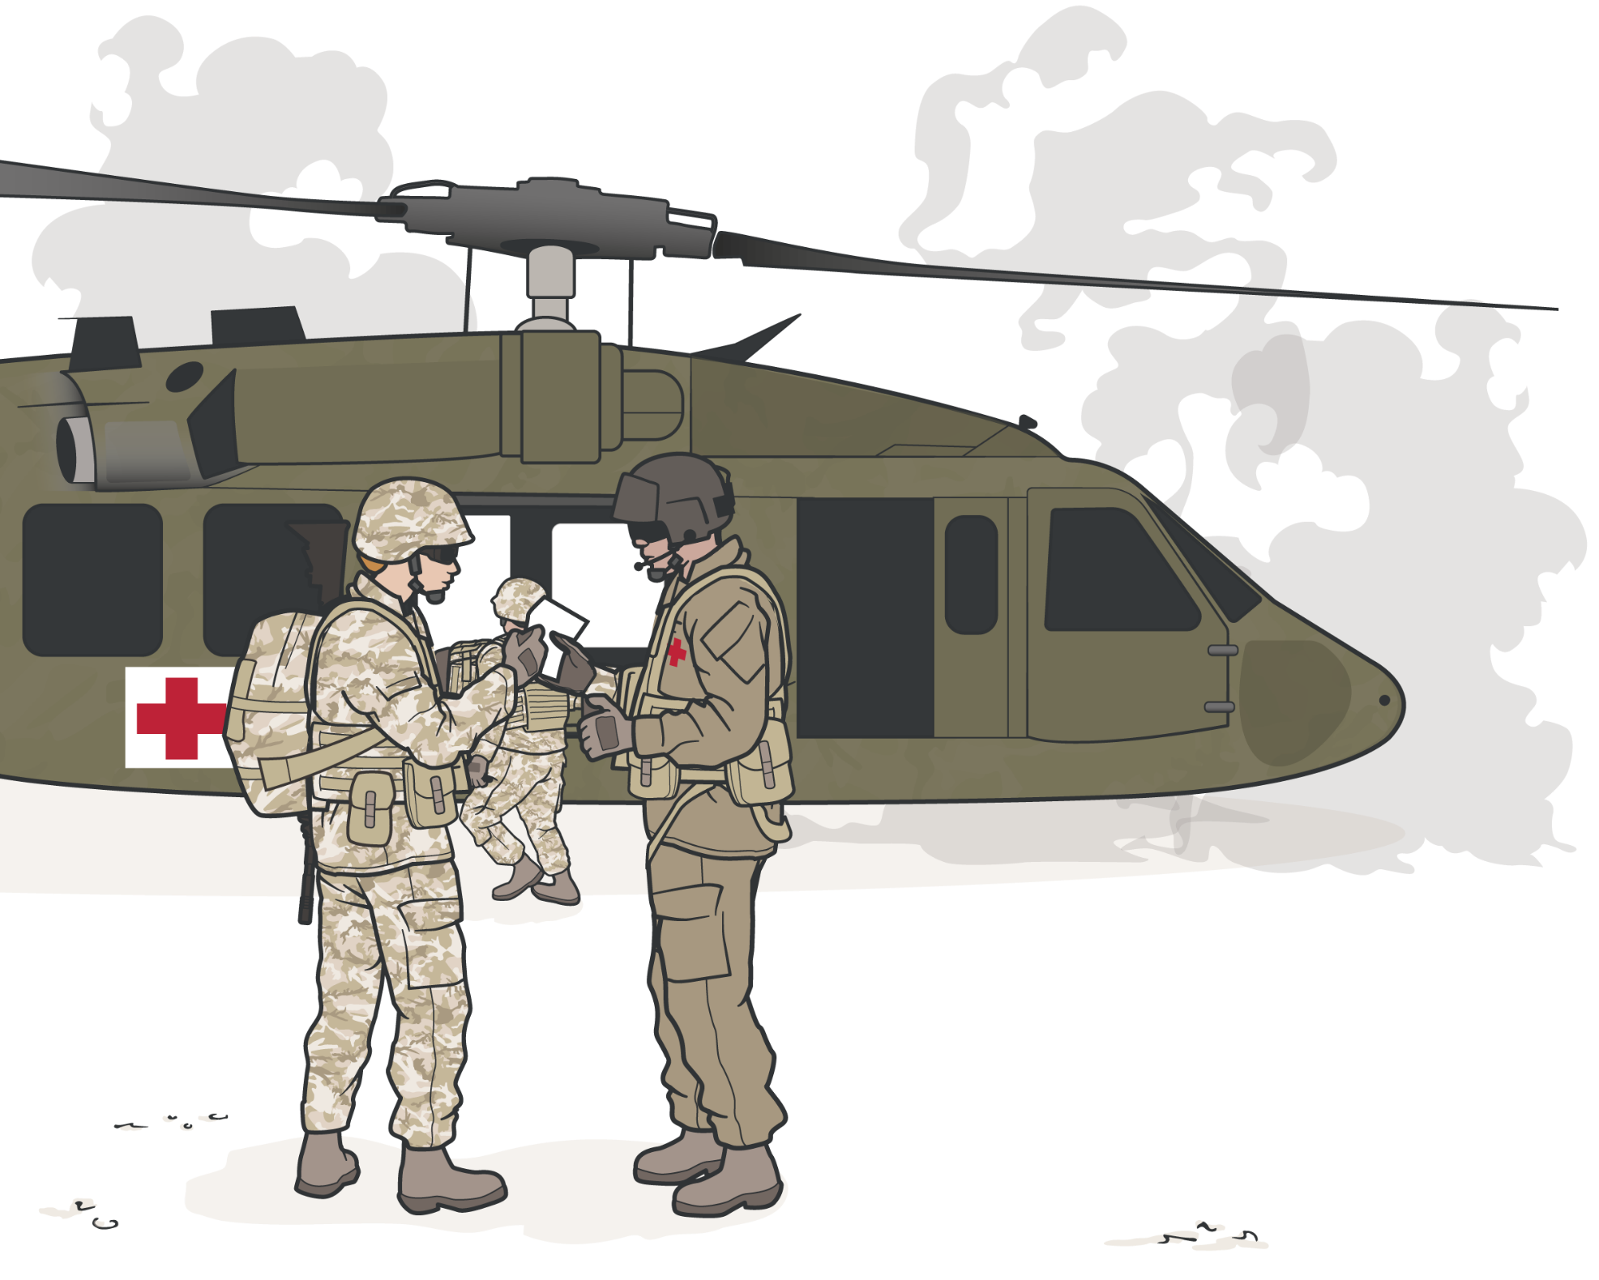
TRANSITIONING CARE
TO EVACUATION PERSONNEL
Module 24: Prepare For Evacuation
Have accurate, completed DD Forms 1380 Have MIST report prepared for each casualty Identify the receiving care provider
Make direct contact (visual, verbal, etc.)
Establish method of communication (radio, verbal, written)
Relay MIST report(s) Answer any questions
NEGATIVE IMPACTS on transition of care:
Hostility threats in exposed environments Reduced ground time (fuel limits, etc.) Engine noise and rotor wash
GOOD casualty care management transfers improve outcomes

Slide 15
PREPARE FOR EVACUATION

Slide 16


PREPARE FOR EVACUATION SKILL STATION
Module 24: Prepare For Evacuation
Litter Selection
Casualty Preparation Casualty Staging Transition of Care

Slide 17
Module 24: Prepare For Evacuation
SUMMARY
Overview of the process of preparing and staging casualties for evacuation
The importance of pre-mission training and evacuation equipment preparation
Litter and evacuation equipment selection Critical actions in preparing casualties
Considerations for evacuation of a casualty with a suspected spinal injury
Considerations for evacuation of ambulatory casualties The process of staging casualties
Responsibilities of tactical force personnel Effective transition of care to evacuation personnel

Slide 18

CHECK ON LEARNING
Module 24: Prepare For Evacuation
Why is it important to perform pre-mission rehearsals of preparation for evacuation?
What goes into selecting a litter?
Name three critical actions in preparing a casualty for evacuation.
How should you arrange casualties when staging them at the evacuation site?

Slide 19



Module 24: Prepare For Evacuation
ANY QUESTIONS?

Slide 20

REFERENCES
Module 24: Prepare For Evacuation
TCCC: Guidelines
by JTS/CoTCCC
Updated regularly – latest edition dated 5 November 2020
These guidelines are the result of decisions made by the Committee on Tactical Combat Casualty Care as they explore evidence-based research regarding best practices
PHTLS: Military Edition, Chapter 25
by NAEMT
Prehospital Trauma Life Support, Military Ninth Edition
NOV 2020

